Slide 1

AWS Cloud-Based Pizza Delivery Application
Phase 3 Presentation | CPSC 454
Anjali Patel, Miguel Macias Meza, Hao Thai

Slide 2

Abstract
The food delivery industry has seen exponential growth, especially with the rise of digital platforms. Specifically, pizza delivery, we as a team can implement a mock ‘Dominoes’ web application hosted on AWS and construct a scalable, secure, and cost-effective pizza delivery application.
Balancing user authentication, order processing, and semi ‘real-time delivery tracking’ (which will be a set time given constraints), AWS cloud provides services that we can leverage to do such tasks.
To note the benefits of AWS cloud services, they provide a robust solution to pizza delivery web application challenge by offering a strong architecture, scalable databases, and secure authentication.
Overall Goal: Create a Serverless Pizza Ordering Web Application

Slide 3

Services & Technologies
Frontend Hosting: AWS Amplify
Backend Logic: AWS Lambda
API Management: AWS API Gateway
Database: Railway (External Database Service)
Authentication: Amazon Cognito
Monitoring Activity: Amazon CloudWatch, Guard Duty, and CloudTrail
Management: Amazon IAM
Payment Card Processing: Stripe (External)
Backend Testing: Postman (External)
Source Code Storage: GitHub (External)
Frontend Framework: NextJS
Backend Framework: NextJS
Backend Environment: NodeJS

Slide 4
System Design & Workflow
User Authentication: Users securely register or log in via Amazon Cognito, which manages authentication and access control.
Order Placement: Authenticated users interact with the frontend via AWS Amplify. Order steps trigger AWS Lambda functions through API Gateway, with multiple functions handling order requests.
Order Processing: Lambda functions validate and process orders, store details in a Railway-hosted MySQL database, and handle payments securely through Stripe. Test data can be used to avoid actual charges.
Monitoring & Security: Amazon GuardDuty monitors for threats, and SNS alerts via email on high-severity issues. IAM roles enforce proper access control for each function.
Development & Testing: Code is versioned in GitHub, and Postman is used to test frontend, backend, and API endpoints.

Slide 5
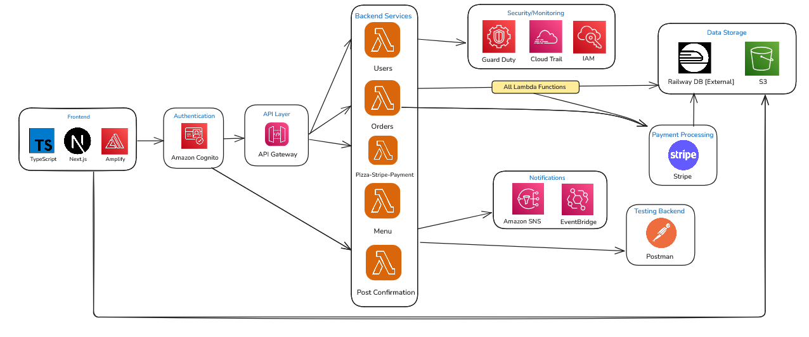
Architecture

Slide 6


Slide 7
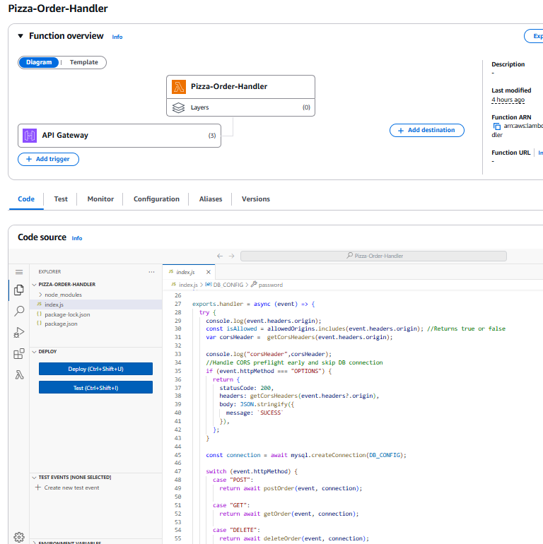
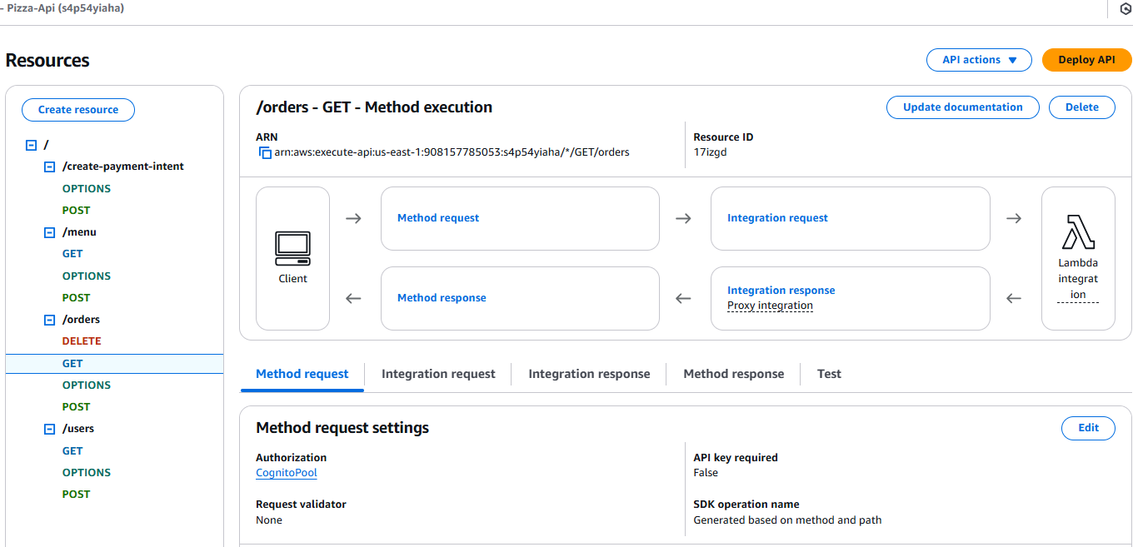
Lambda Function Triggers & API Gateway

Slide 8
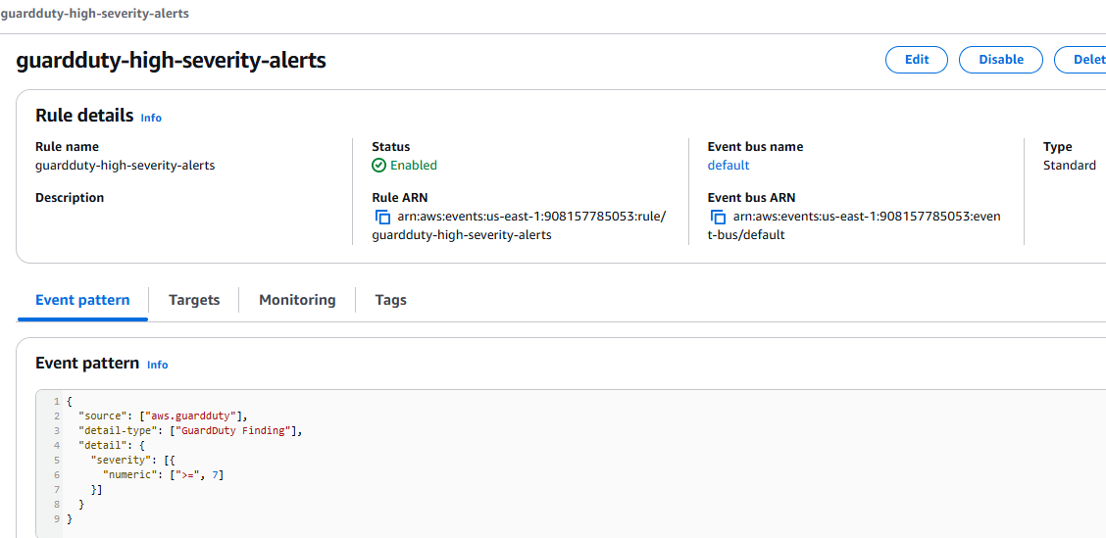
EventBridge & SNS & GuardDuty

Slide 9
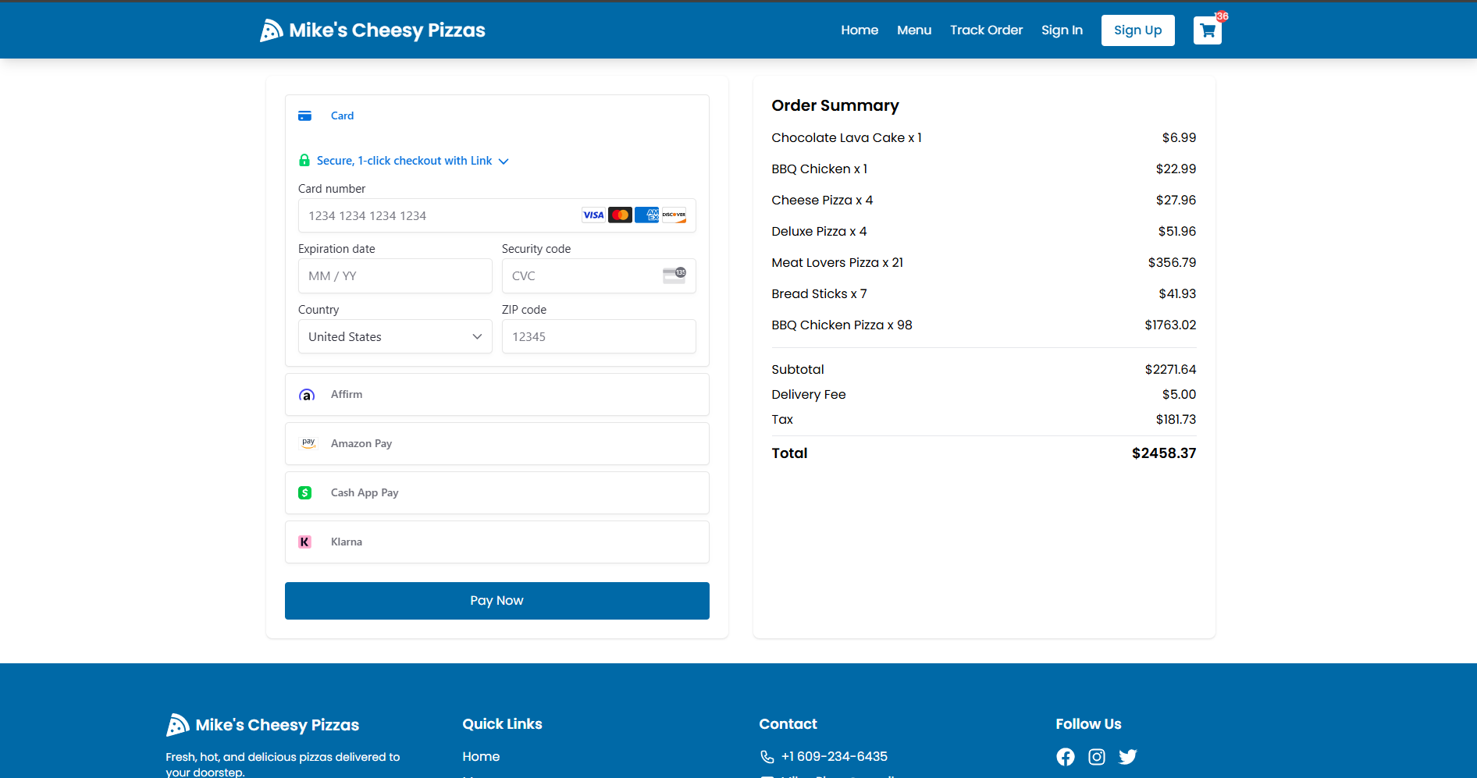
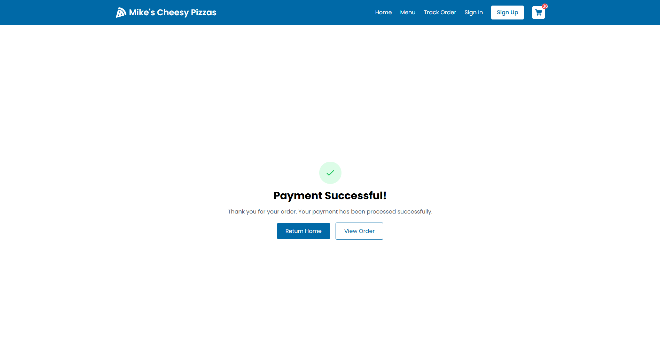
Stripe Processing

Slide 10

Challenges
Migrated from Amplify Gen 1 + Vite to Gen 3 + Next.js, requiring custom auth forms due to issues with AWS's React components.
Encountered errors configuring Cognito user pools on API Gateway routes, causing delays with both console and CLI methods.
CORS misconfiguration was caught late due to a teammate’s browser plugin masking the issue during development.
Used a post-confirmation Lambda trigger to store Cognito users in RDS for added flexibility.
Switched from AWS RDS to Railway for a more cost-effective, persistent MySQL database during development.
Testing was hindered by service dependencies, leading to use of dummy data and delayed integration tests.
Resolved IAM and service visibility issues by developing under a shared AWS root account.

Slide 11

Benefits
Scalability: AWS Lambda & API Gateway scale automatically without server management.
Fast Deployment: Amplify enables quick GitHub-linked deployments (with webpack considerations).
Secure Authentication: Cognito handles sign-up/sign-in with robust user management.
Managed Database: Railway offers a scalable MySQL solution easily integrated with AWS.
Monitoring & Security: GuardDuty alerts and logs threats for quick mitigation.
Cost Efficiency: Replaced costly services (e.g. RDS) with free/cheaper alternatives to minimize expenses.

Slide 12
Future Extensions
Secrets Manager Integration: Securely manage environment variables for Lambda-database connections.
Data & AI Integration: Use AWS AI to support user chatbots or internal performance insights via Amplify.
Google Analytics: Track site usage, traffic, and popular items through Amplify-linked analytics.
Alternate Database Setup: Easily switch to any MySQL-compatible service via environment variable updates.
Admin View Completion: Finalize admin panel for managing users through Lambda-connected MySQL functions.

Slide 13
Conclusion
Successfully built a scalable and cost-effective pizza delivery application using AWS serverless architecture and external services.
Leveraged key services including:
AWS Lambda for backend logic
Railway (MySQL) for user data storage
Stripe for secure payment processing
GuardDuty for monitoring and maintaining security
Overcame team changes and technical challenges with IAM and authentication.
Gained hands-on experience and a deeper understanding of AWS technologies through persistence and collaboration.

Slide 14
References
[1] Amazon Web Services, "AWS Documentation," Amazon, Accessed: Mar. 10, 2025. [Online]. Available: https://aws.amazon.com/documentation/.
[2] HashiCorp, "Terraform Documentation," Terraform by HashiCorp, Accessed: Mar. 9, 2025. [Online]. Available: https://www.terraform.io/docs/.
[3] Meta, "Getting Started – React," React Documentation, Accessed: Mar. 6, 2025. [Online]. Available: https://reactjs.org/docs/getting-started.html.
[4] Amazon Web Services, "Amazon Aurora," AWS RDS, Accessed: Mar. 10, 2025. [Online]. Available: https://aws.amazon.com/rds/aurora/.
[5] CloudZero, "Aurora vs. RDS: Choosing The Best AWS Database Solution," CloudZero Blog, Accessed: Mar. 12, 2025. [Online]. Available: https://www.cloudzero.com/blog/aurora-vs-rds/.
[6] S. S. Rajan, "How to use AWS Cognito to build an Authentication / Login System," YouTube, Aug. 18, 2020. [Video]. Available: https://www.youtube.com/watch?v=8a0vtkWJIA4. [Accessed Mar. 12, 2025].
[7] Amazon Web Services, "AWS Blogs," Amazon, Accessed: Mar. 12, 2025. [Online]. Available: https://aws.amazon.com/blogs/.

Slide 15
Thank You
Any Questions?

